Slide 1













BON APPETIT
A psychological horror tale where a grieving father's culinary Obsessions Mask a sinister Truth
Beautiful Facade
Grieving Father
Two Young Daughters
Film Producer Pitch Deck

Slide 2












Logline & Synopsis
Logline
Following the tragic death of his wife, a grieving father descends into madness, serving his two daughters increasingly sinister meals, forcing the elder sister to plot their escape before they become the main course.
Synopsis
"Bon Appetit" delves into a chilling narrative that explores the depths of grief, the breakdown of family, and the terrifying descent into psychological horror.
Act 1: seemingly idyllic family life shattered by mother's tragic death
Act 4: younger sister's growing suspicion and terror
Act 5: elder sister's desperate escape plan
Act 2: father's culinary skills transform into disturbing ritual
Setting: beautiful exterior masking sinister interior
Act 3: elder daughter discovers disturbing trophies
Psychological Horror | Family Drama

Slide 3










Themes & Tone
Core Themes
Cannibalism as Metaphor
Fragility of Family
Explores cannibalism as metaphor for consumption of grief and family
Shows how tragedy can unravel family foundations
Mask of Normalcy
Psychological Horror
Evil hiding behind normal appearance
Betrayal of trust within intimate circle
Tone
"Bon Appetit" blends psychological horror with family drama and social commentary, creating a narrative that is thought-provoking and terrifying. The film maintains a veneer of domestic normalcy while exploring the darkest corners of grief and human depravity.
Psychological Horror | Family Drama

Slide 4



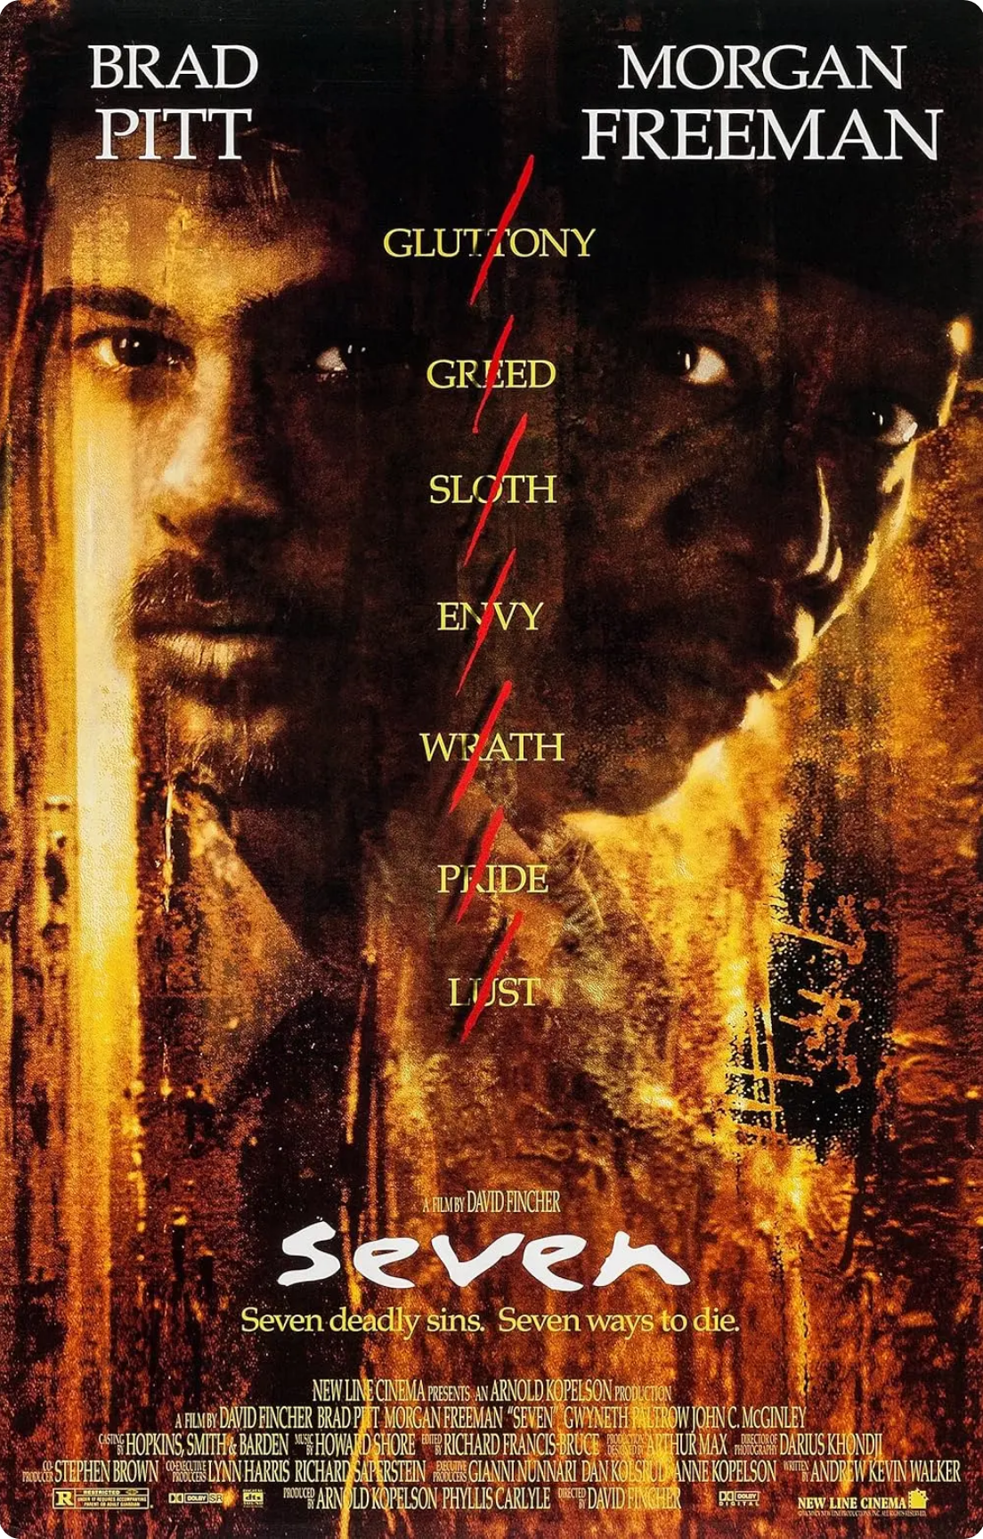









Cinematic Influences
Silence of the Lambs
Get Out & Them
Hannibal Lecter's deceptive normalcy while harboring monstrous secrets. The father in "Bon Appetit" maintains a similar veneer of respectability while concealing his true nature.
Using psychological horror to explore the Black experience. "Bon Appetit" follows this tradition by examining grief and family breakdown through a lens that highlights societal anxieties.
Se7en
American Psycho
The grim, methodical tone and exploration of profound human evil. The father's calculated descent into madness mirrors the systematic depravity depicted in this classic.
The critique of a meticulously constructed facade masking hidden depravity. The father's outwardly composed demeanor while preparing sinister meals draws from this film's themes.
Sinners
The integration of African imagery and cultural elements enriches "Bon Appetit" by adding layers of depth and cultural specificity to the horror. This creates a unique visual and thematic tapestry.
Our Approach
"Bon Appetit" masterfully blends these influences, creating a unique narrative that explores the psychological breakdown of a family through the lens of horror, while incorporating African cultural elements to add depth and specificity.
Psychological Horror | Family Drama

Slide 5











Visual Aesthetic
The Power of Juxtaposition
"Bon Appetit" juxtaposes a beautiful, architecturally pleasing home with the psychological horror within, creating visual dissonance that heightens the sense of unease.
VS
Visual Dissonance Elements
Contrast between warm, inviting architecture and cold, calculated horror
Beautiful table settings with unidentifiable, disturbing meals
Deceptive normalcy of the father's appearance masking his monstrous acts
Visual Impact
This deliberate contrast makes the audience question the safety and sanctity of home, creating maximum tension andunsettling the audience's sense of security.
Beautiful Exterior
Psychological Horror | Family Drama

Slide 6
















Characters & Casting
The Father
Elder Daughter
Younger Daughter
Background: Once a loving patriarch, now hollowed by grief
Background: Sharp, observant, and protective
Background: More innocent and vulnerable
Motivation: Love for daughters twisted into predatory obsession
Role: Audience's anchor, growing suspicion drives the plot
Role: Embodies the stakes of their survival
Dynamics: Childlike trust and dependence on older sister
Dynamics: Gradual descent, maintaining normalcy while committing monstrous actions
Dynamics: Protective of younger sister, piecing together the horror
Casting:
Casting:
Casting:
Ideal: Jeffrey Wright (conveying intellect, sadness, and menace)
Ideal: Marsai Martin (intelligent, determined survivor)
Ideal: Naya Desir-Johnson (innocent, vulnerable)
Cultural Context: All-African American cast to add layers of cultural depth and authenticity to the family's story.
Character-driven storytelling with diverse representation

Slide 7











Creative Vision
"Bon Appetit" requires a director who can balance psychological horror with profound family drama and incisive social commentary.
Jordan Peele
Ryan Coogler
Known for "Get Out" and "Us," Peele crafts narratives that use horror to explore societal anxieties.
Director of "Fruitvale Station" and "Black Panther," with a talent for character-driven storytelling and cultural resonance.
Social Commentary
Psychological Depth
Cultural Context
Emotional Weight
Core Expertise
Balancing tone and thematic elements
Psychological transformation of characters
Sharp social critiques through genre
Psychological Horror | Family Drama

Slide 8


















Production Strategy
Proof of Concept
Production Approach
One-day shoot to produce a compelling short film that demonstrates:
One-day shoot focused production to maximize efficiency
Unique tone and psychological horror elements
Dedicated cast and crew selected for their expertise in psychological drama
Visual style and aesthetic of the project
Viability as a feature film or television series
Efficient planning to ensure optimal creative output within constraints
Festival Circuit
Budget
$10,000+
Sundance
Tribeca
January
April
Minimum production budget
Strategic submission to prestigious film festivals to generate critical acclaim and industry attention
Allocated to ensure high production value and creative potential
Psychological Horror | Family Drama

Slide 9















Festival Circuit & Distribution
Festival Strategy
Target Festivals
Strategic Goals
Sundance Film Festival
Garner critical acclaim from industry professionals
January, Park City, UT
Attract attention from film buyers and distributors
Tribeca Film Festival
Position "Bon Appetit" within the independent horror genre
April, New York, NY
Distribution Approach
Theatrical Release
Digital Streaming
International Festivals
Limited theatrical run in select cities
VOD platforms for wider audience
Expand to global film circuits
Strategic Distribution Plan

Slide 10








Future Development
"Bon Appetit" offers significant long-term potential, adaptable to multiple platforms while maintaining its core themes of psychological horror and family dynamics.
Feature Film
Limited TV Series
Deeper psychological exploration of the father's descent
Extended backstory of the mother's tragic death
Nuanced development of the father's gradual unraveling
Enhanced horror elements within the home
Complex character development of the daughters' resilience
Character study of the daughters' survival instincts
"A powerful and disturbing cinematic experience"
"A prolonged and immersive journey into the chilling world of 'Bon Appetit'"
Submit to prestigious festivals while developing multi-platform strategy
Psychological Horror | Family Drama

